Slide 1



Slide 2
King of Glory
Proposed A/V Pilots
Equipment Upgrade Locations
2026

Slide 3
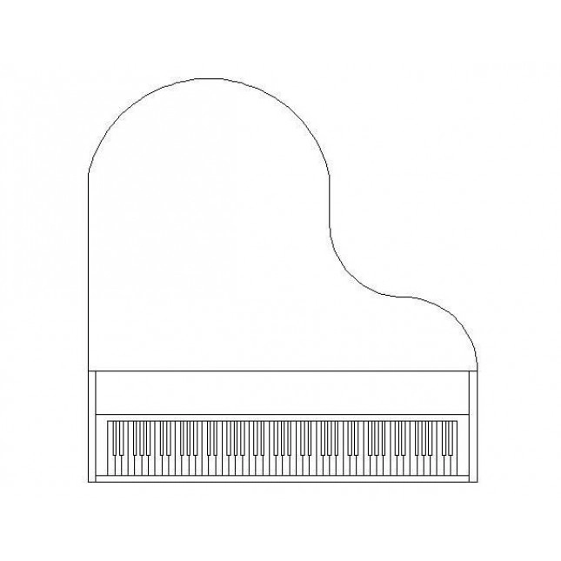
KOG Sanctuary
Control Desk w/ Racks
NEW Audio Console – Remote Control
Choir Display
NEW Controller & Switcher
A/V Pilot
Upgrades
In RED
Camera Locations
Rear
Display
Rear Speaker
Right Display
NEW Camera Locations
Front Speakers
Left Display
NEW Camera Location

Slide 4
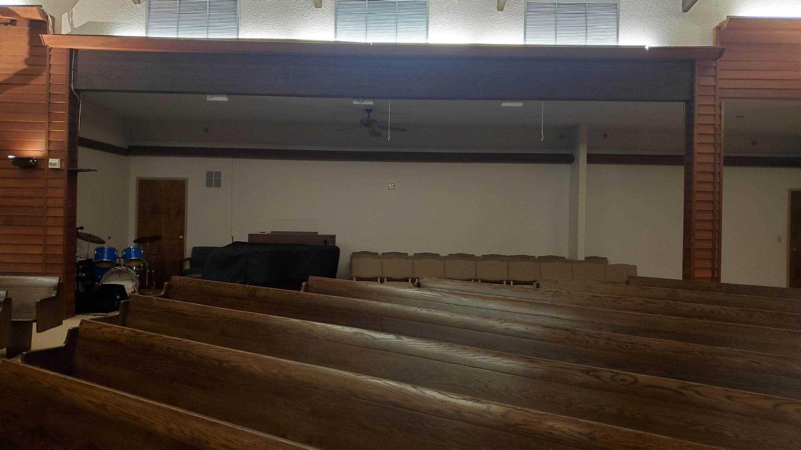
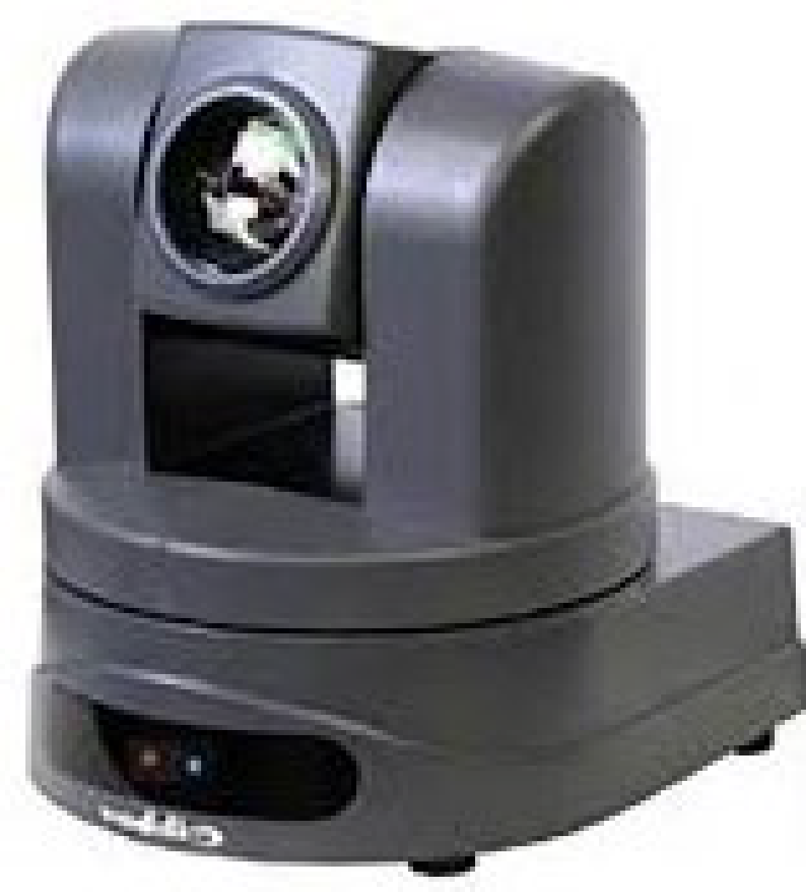
2
1
Camera Locations

Slide 5
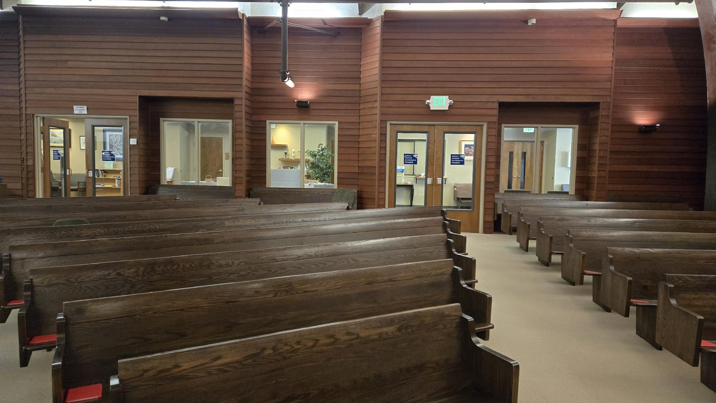
3
4
NEW
Camera Locations

Slide 6
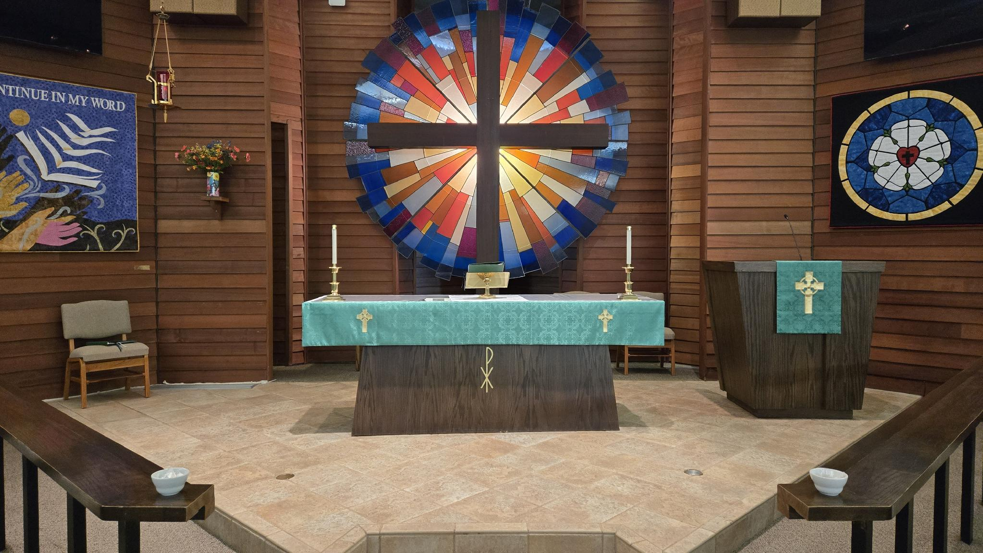
5
NEW
Camera Location

Slide 7
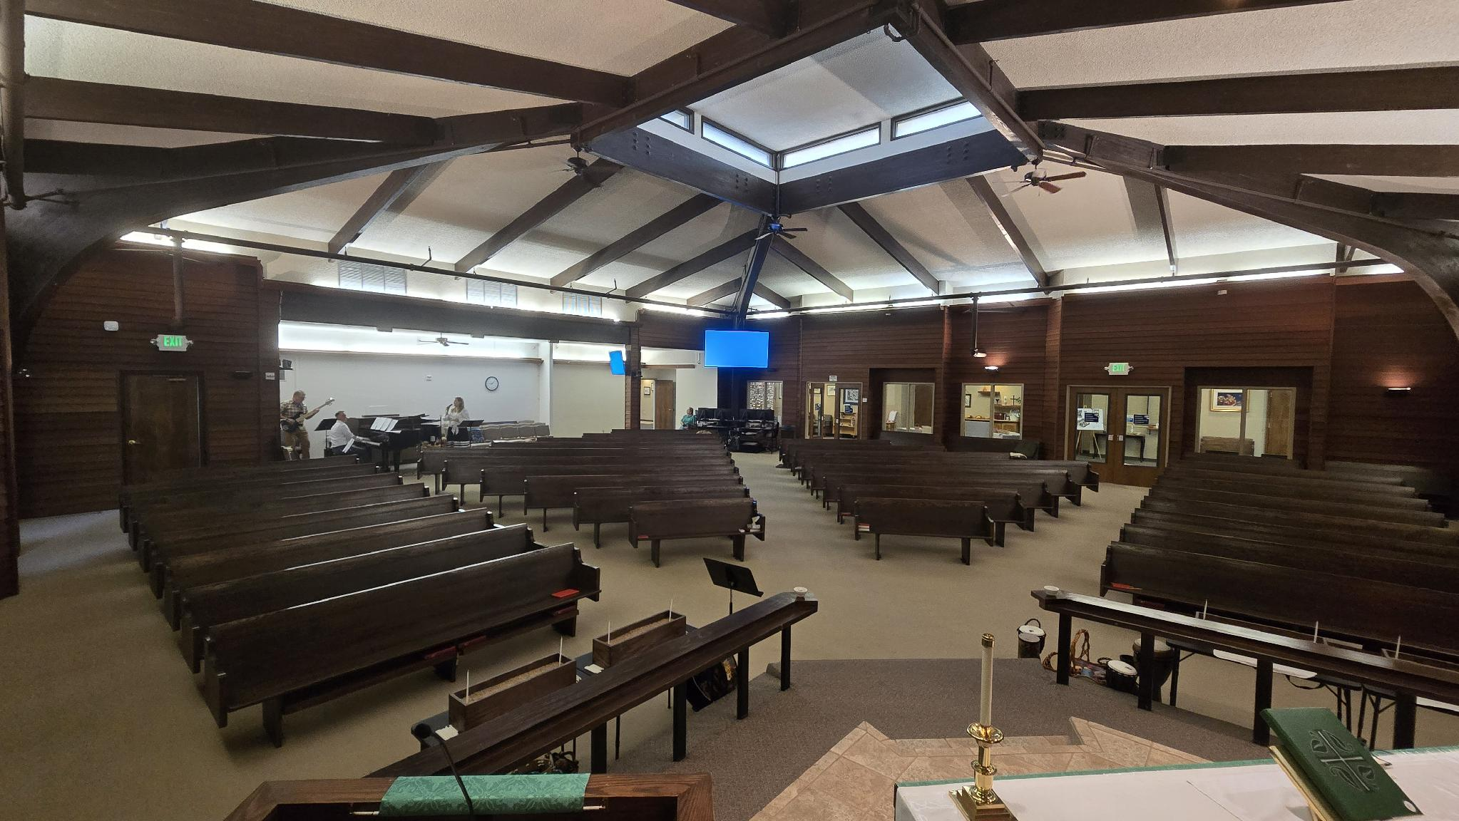
2
1
3
4
NEW
Camera Locations

Slide 8
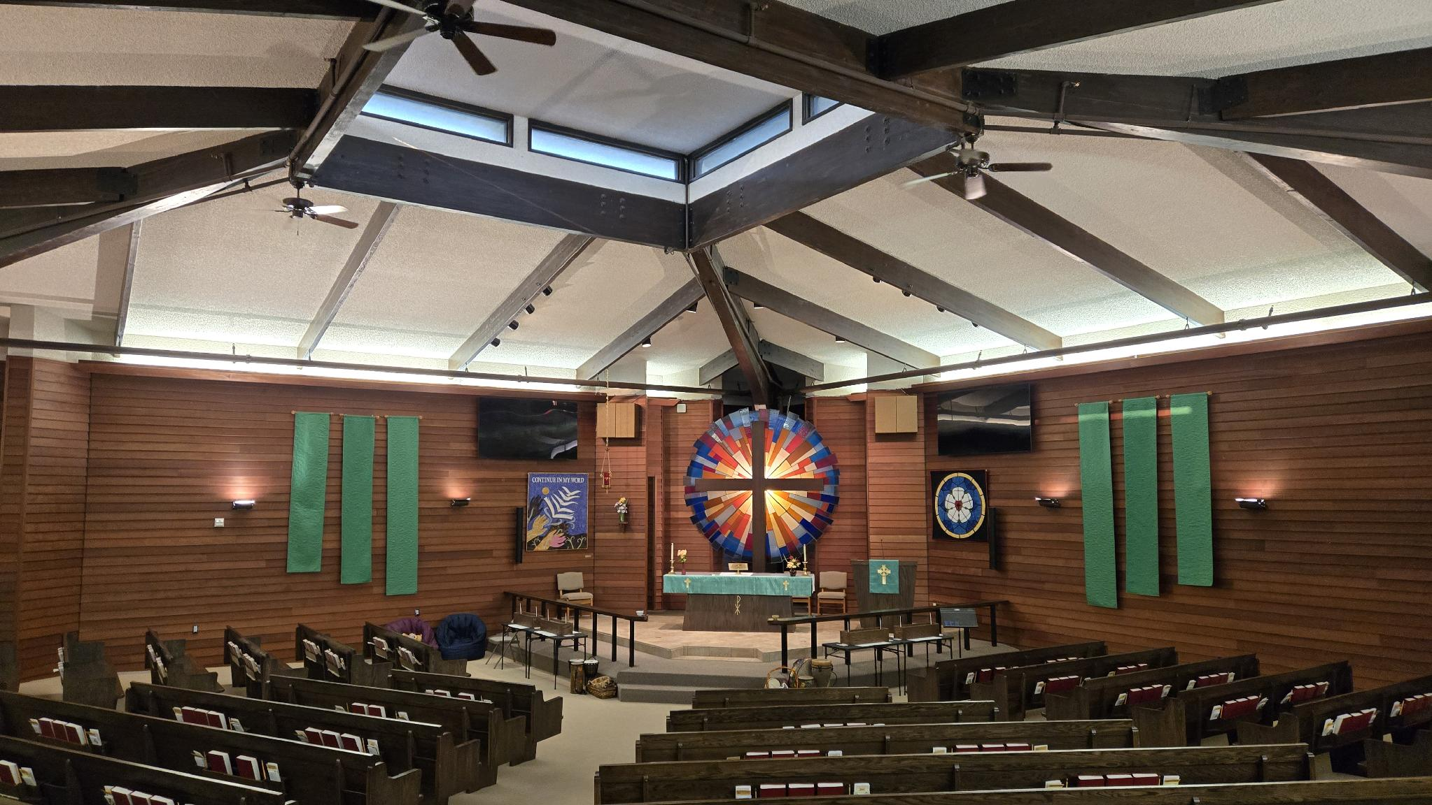
- CAMERA ONE -

Slide 9
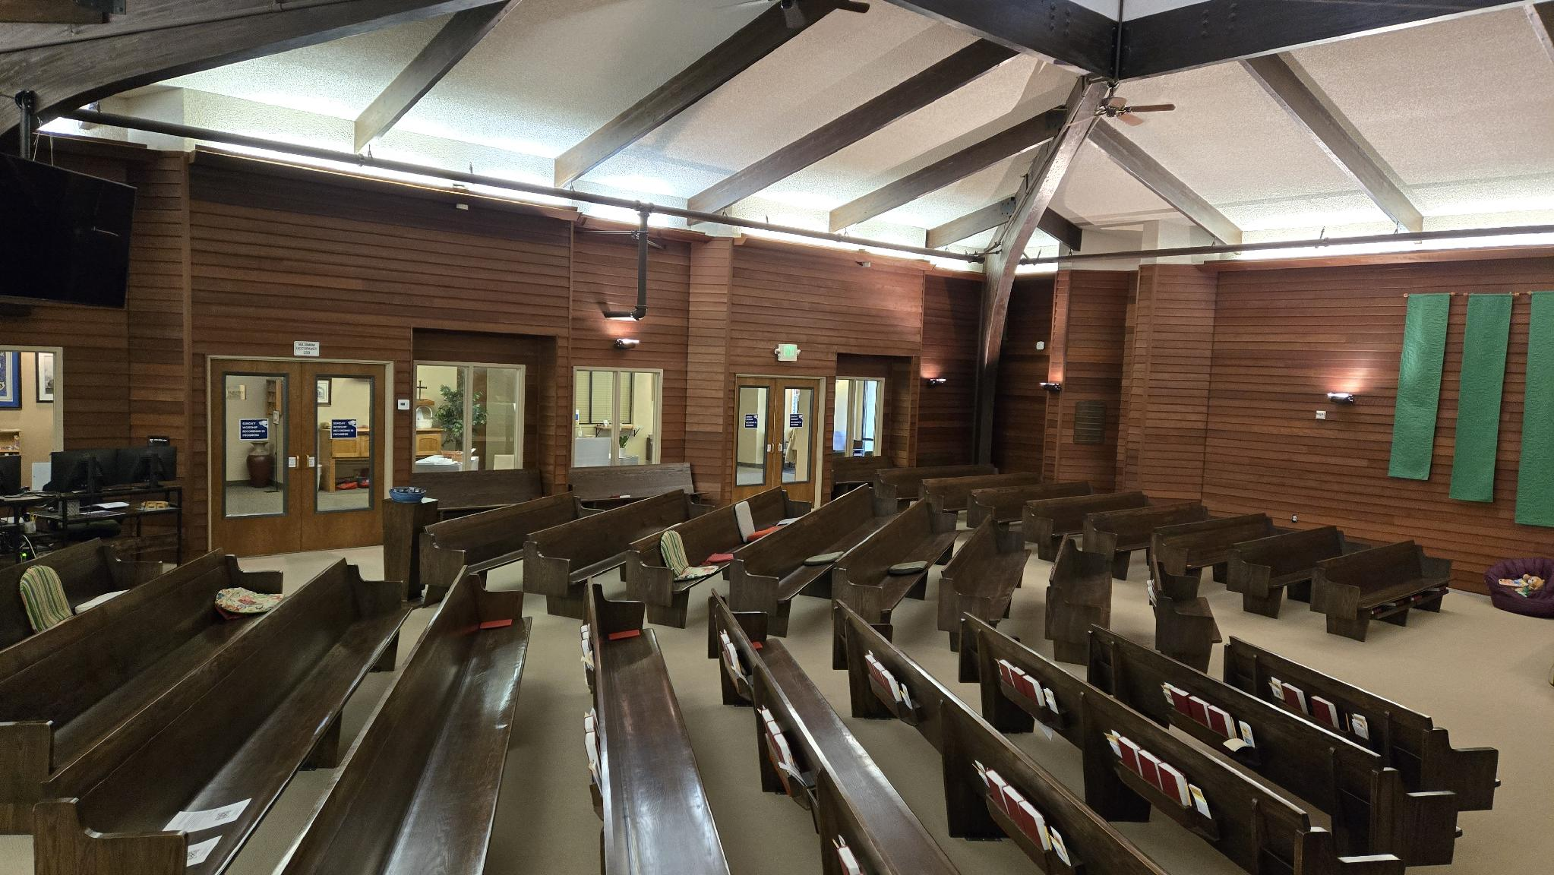
- CAMERA TWO -

Slide 10
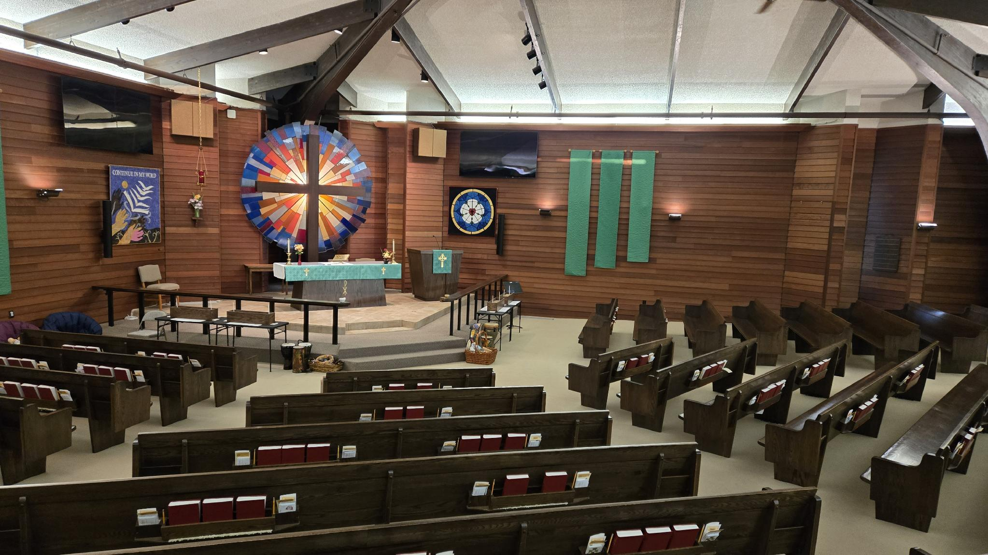
- CAMERA THREE -

Slide 11
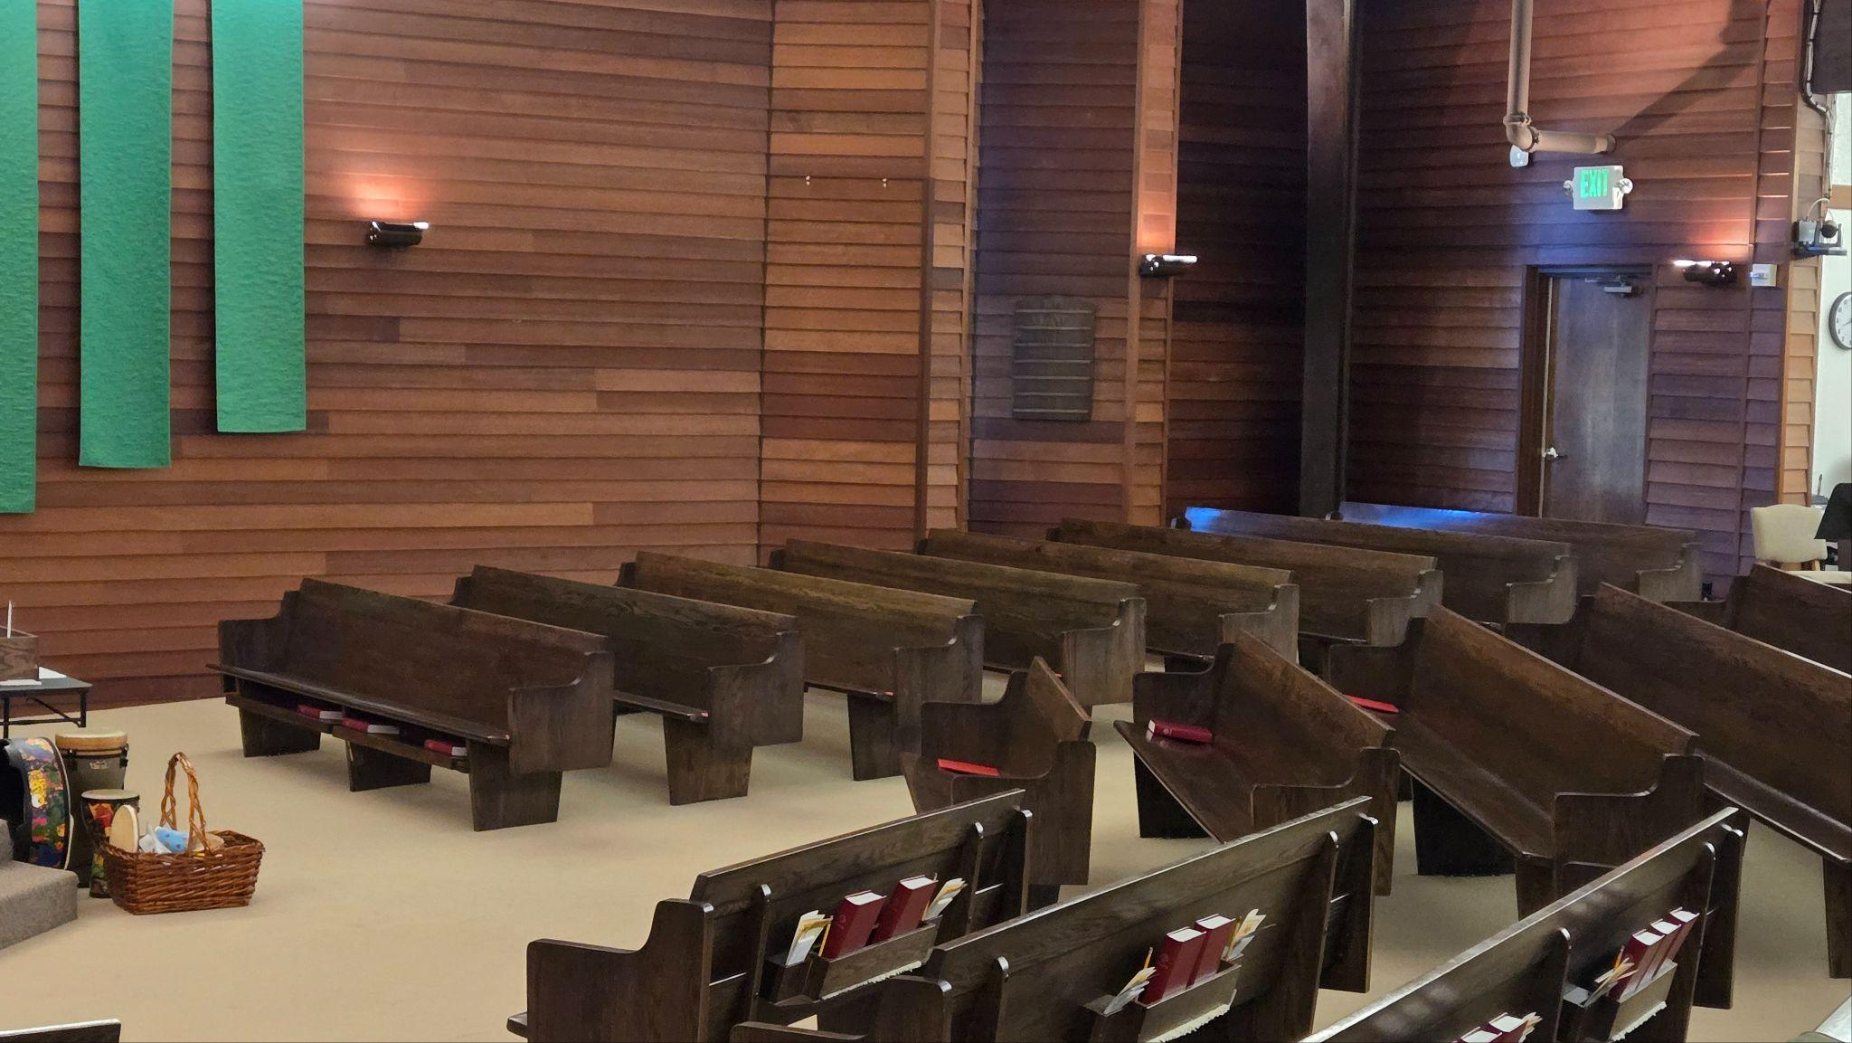
- CAMERA FOUR -

Slide 12
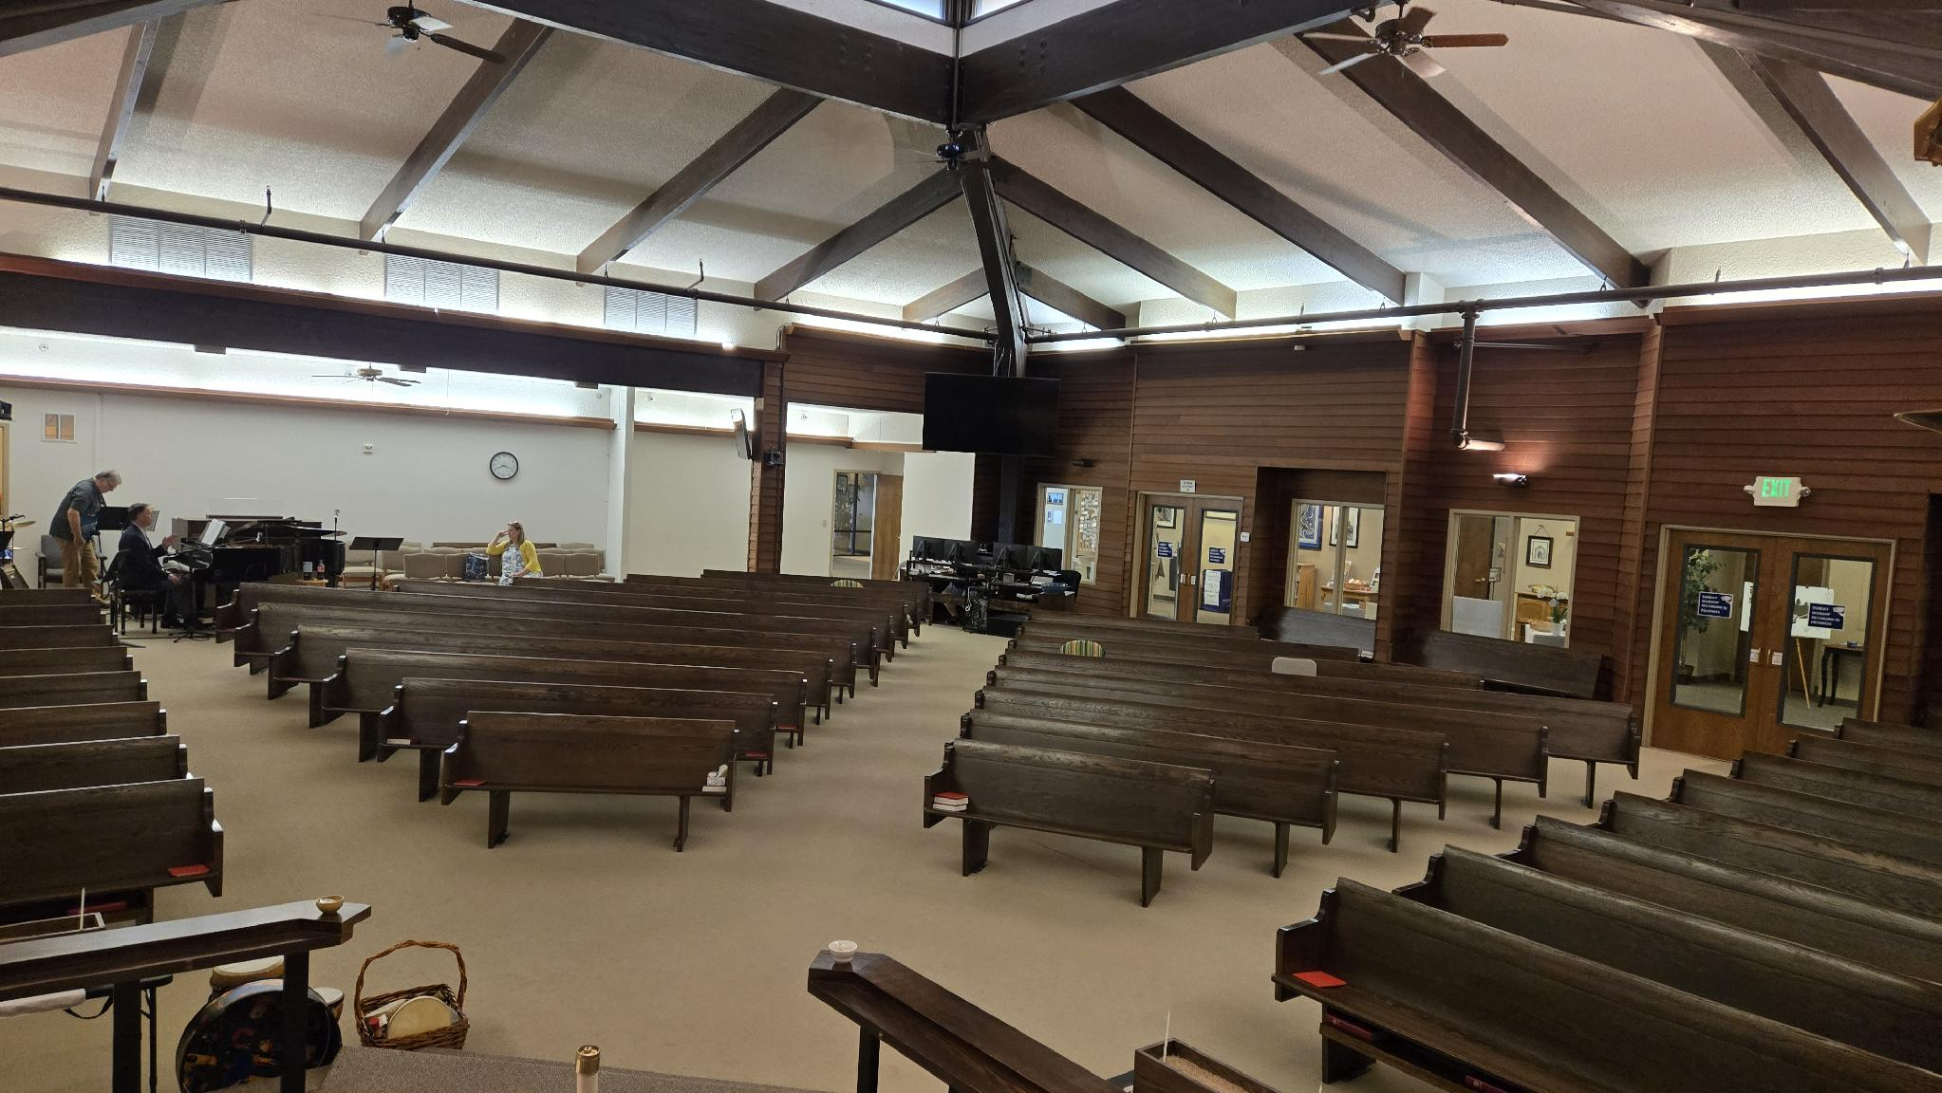
- CAMERA FIVE -

Slide 13
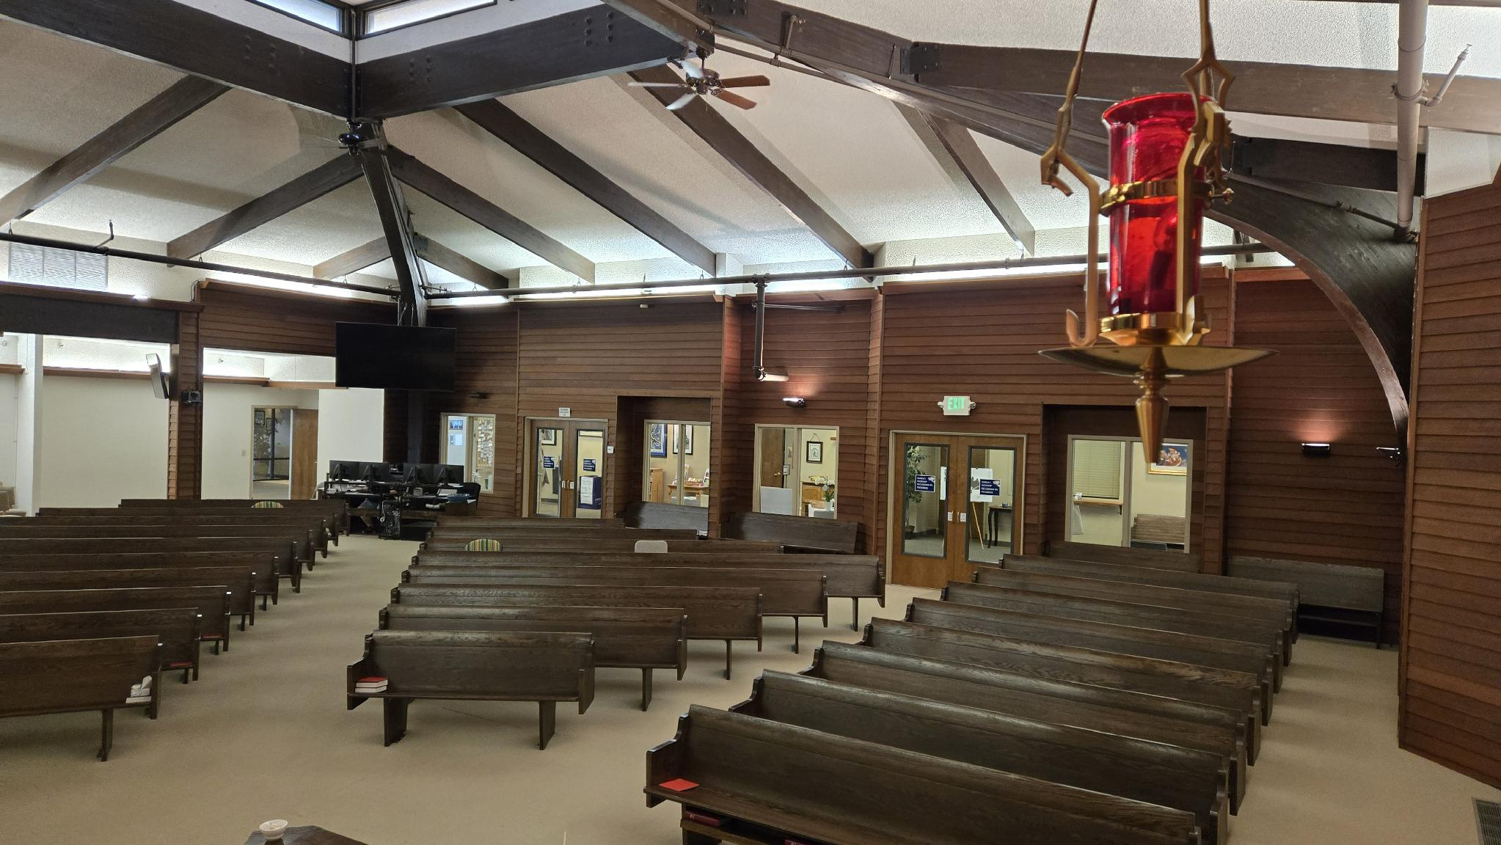
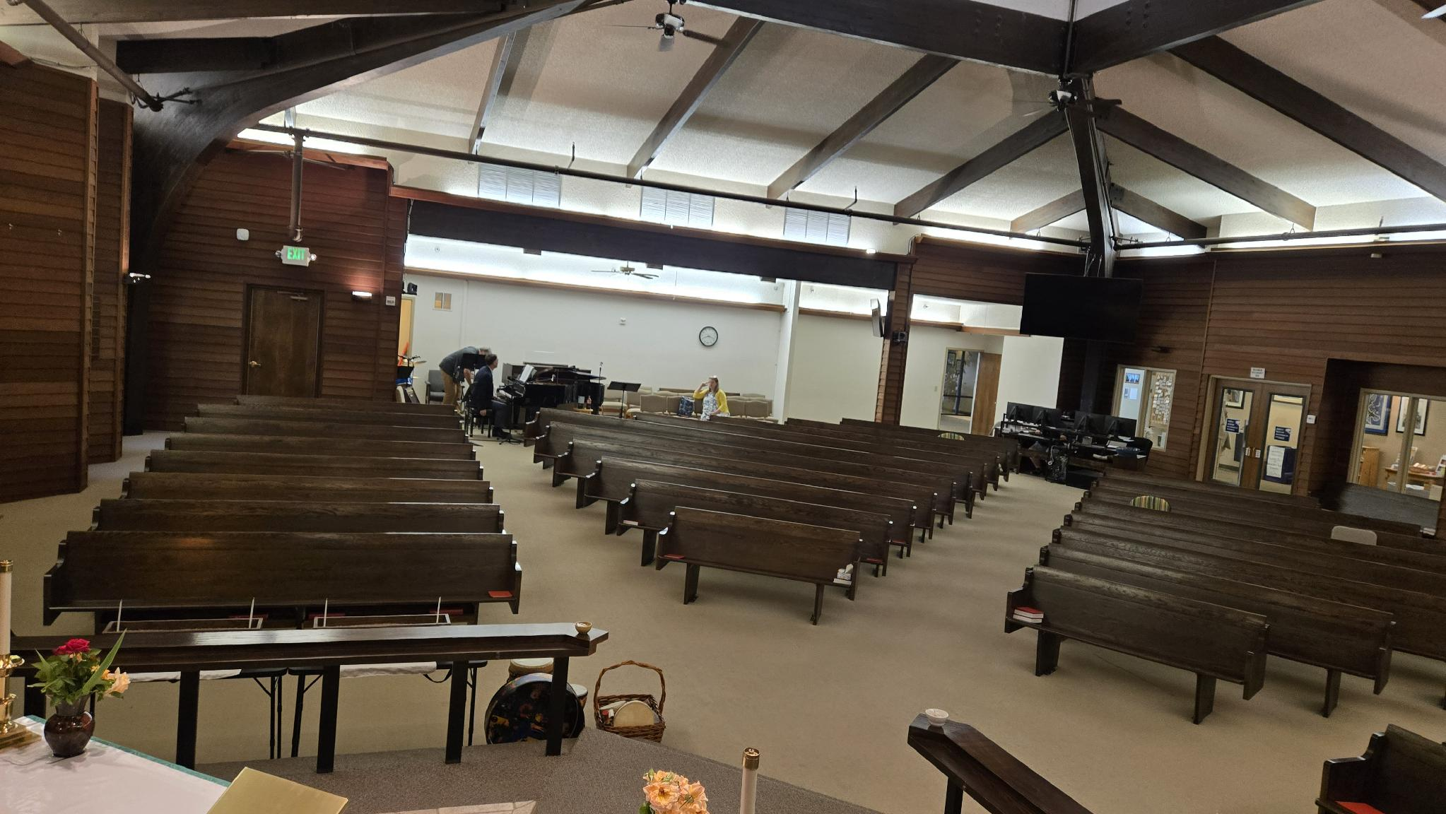
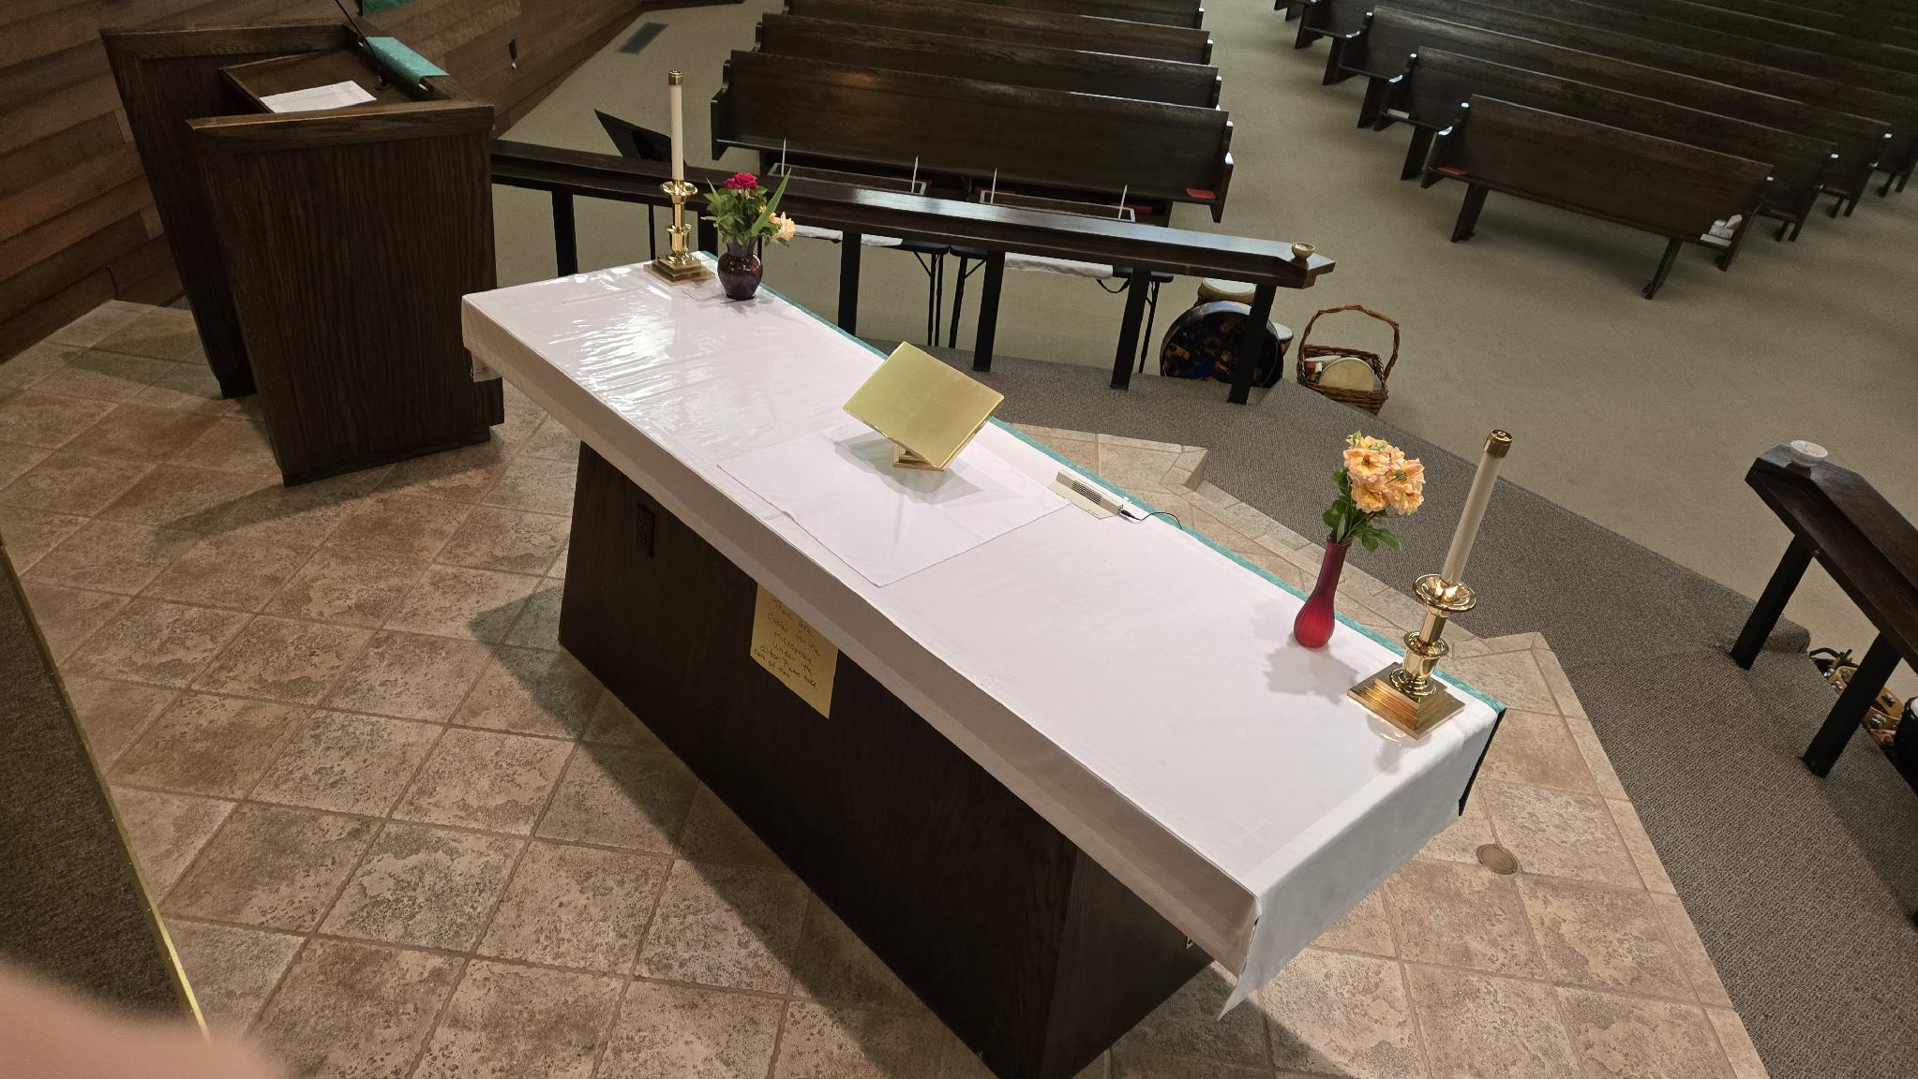
- CAMERA FIVE -

Slide 14
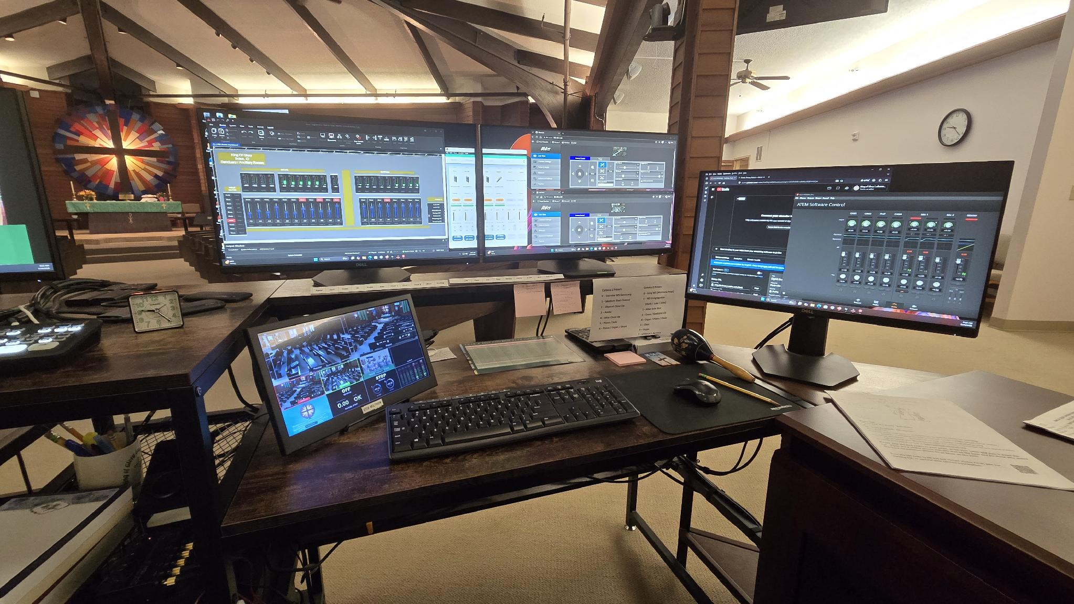
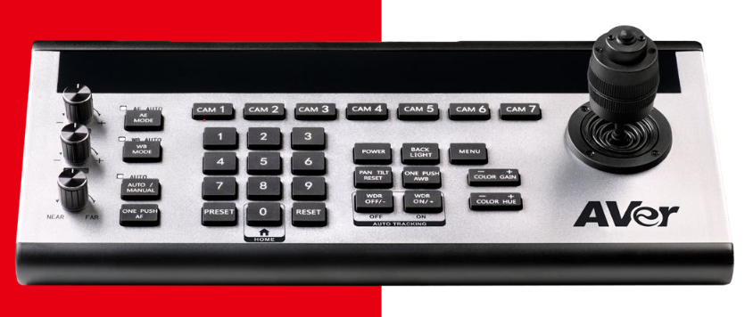
NEW
Camera Controller

Slide 15
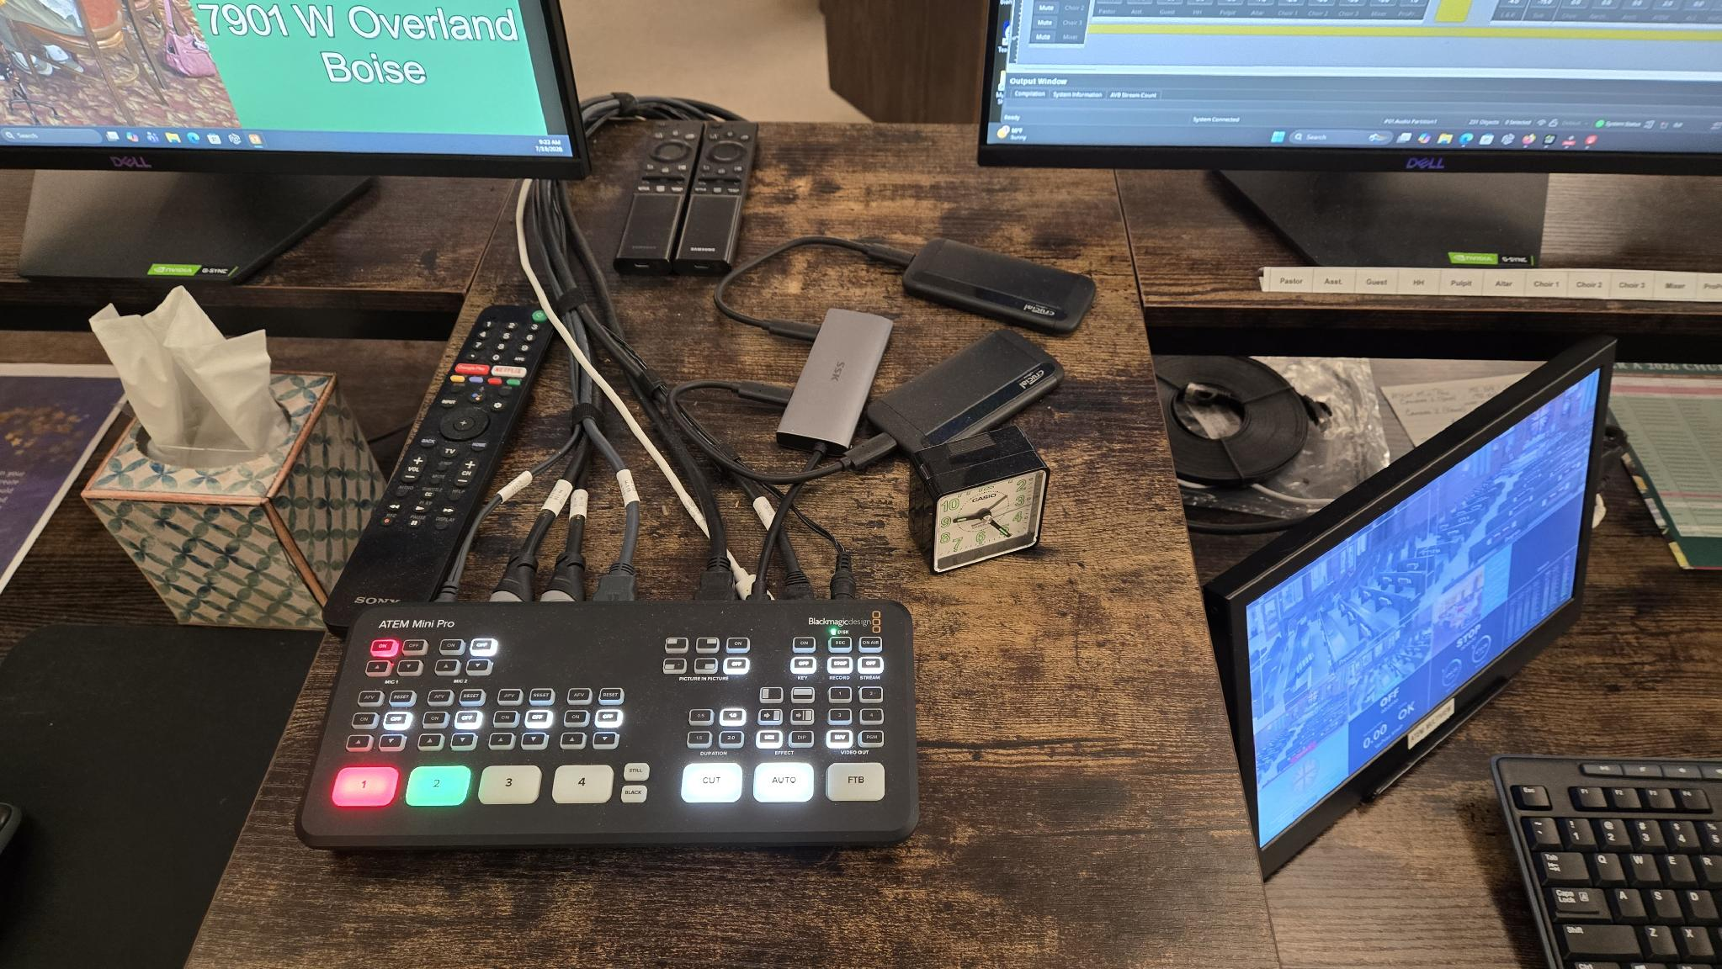
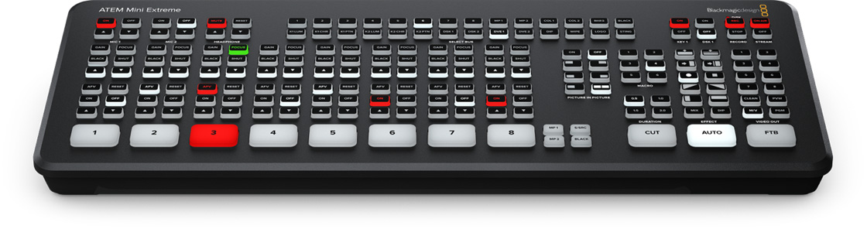
NEW
ATEM Switcher

Slide 16
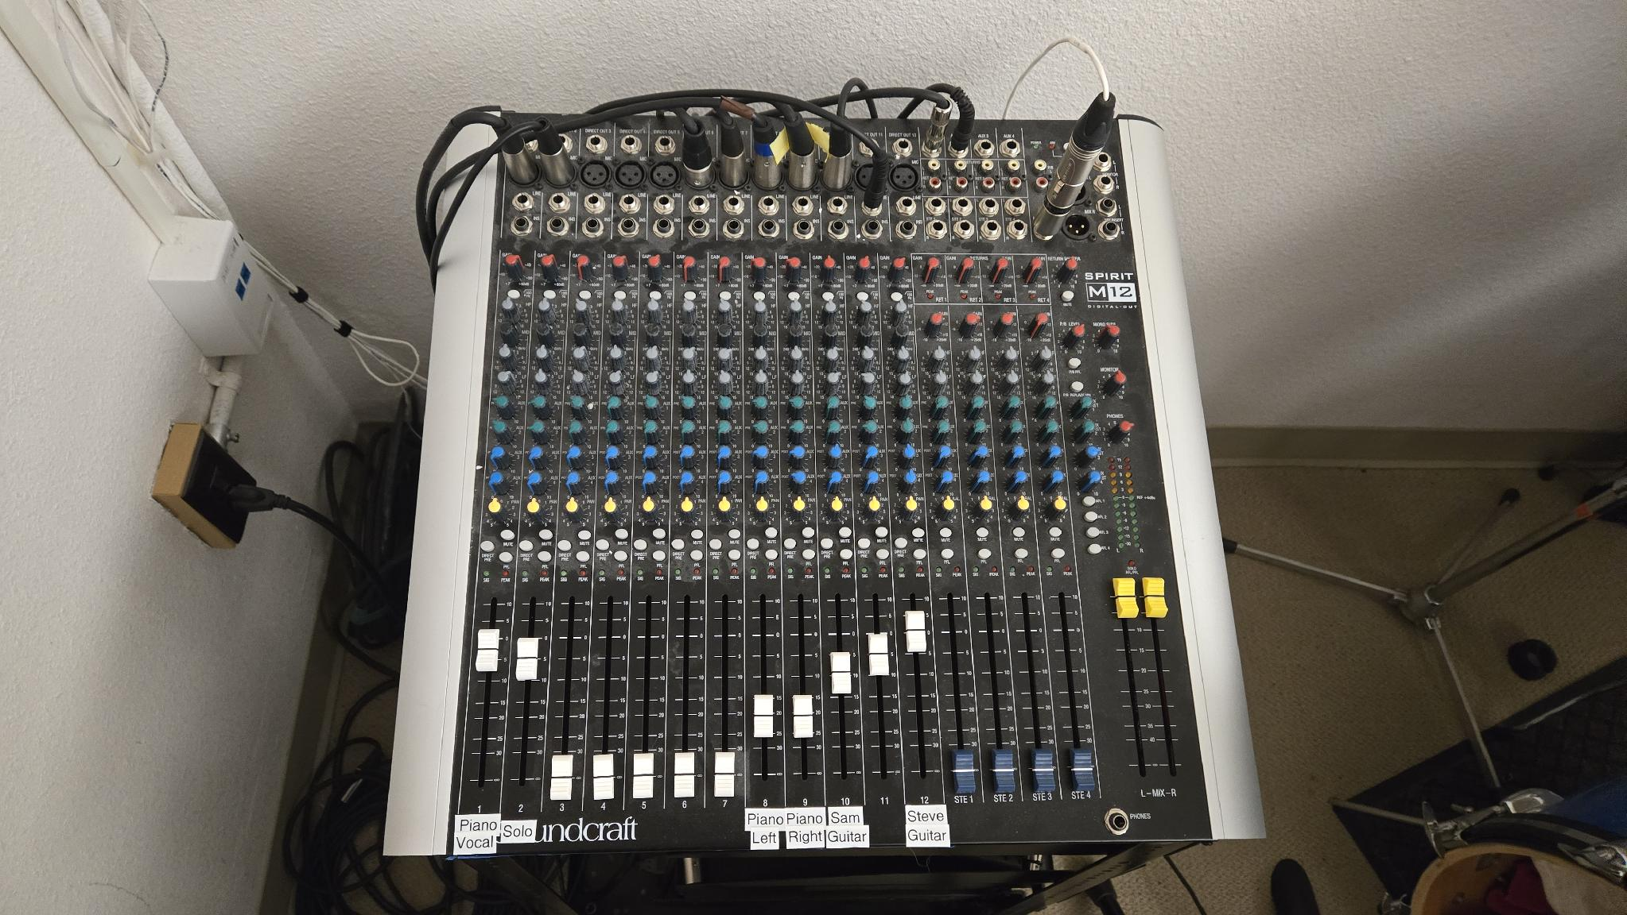
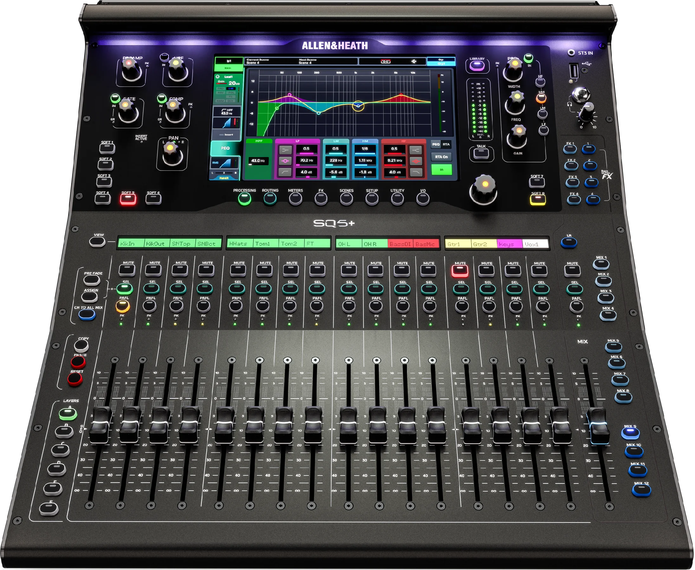
NEW
Audio Console –
Remote Control

Slide 17
Thank you
Any Questions ?
For More Information
Wes or Dawn Lewis on behalf of
FORTE Greg Nettles

